Slide 1

“Raspberry Jam” Monitoring your world
JAM

Slide 2
JAM Home Monitoring System
JAM
Our Goal: Design an inexpensive and configurable home security that can be monitored from anywhere in the world
Our design will be able to do the following:
Detect Motion
Sound an Alarm
Stream live video
Measure room temperature and brightness levels
Provide system alert notifications via email
All features configurable and accessible remotely

Slide 3
Compared to the Market
JAM
Inexpensive relative to a subscription based home security system
Price point lower than comparable solutions (Nest)
Easy to set up
Offers more user customization for power users

Slide 4
Technical Specifications/Performance
JAM
Feature | Specifications
Size and weight | 120 cubic inches; 3 lbs
Video Output | 1080p continuous video stream
Power Consumption | 0.08 kWh/month if active at all times
Motion Sensor Range (Maximum room size) | 20 feet
Alarm | Store up to 5 custom alarm sounds at any time
Connectivity | Any device with an internet connection and HTML5 capable web browser
Hardware Add-ons | Temperature Sensor, Light sensor

Slide 5
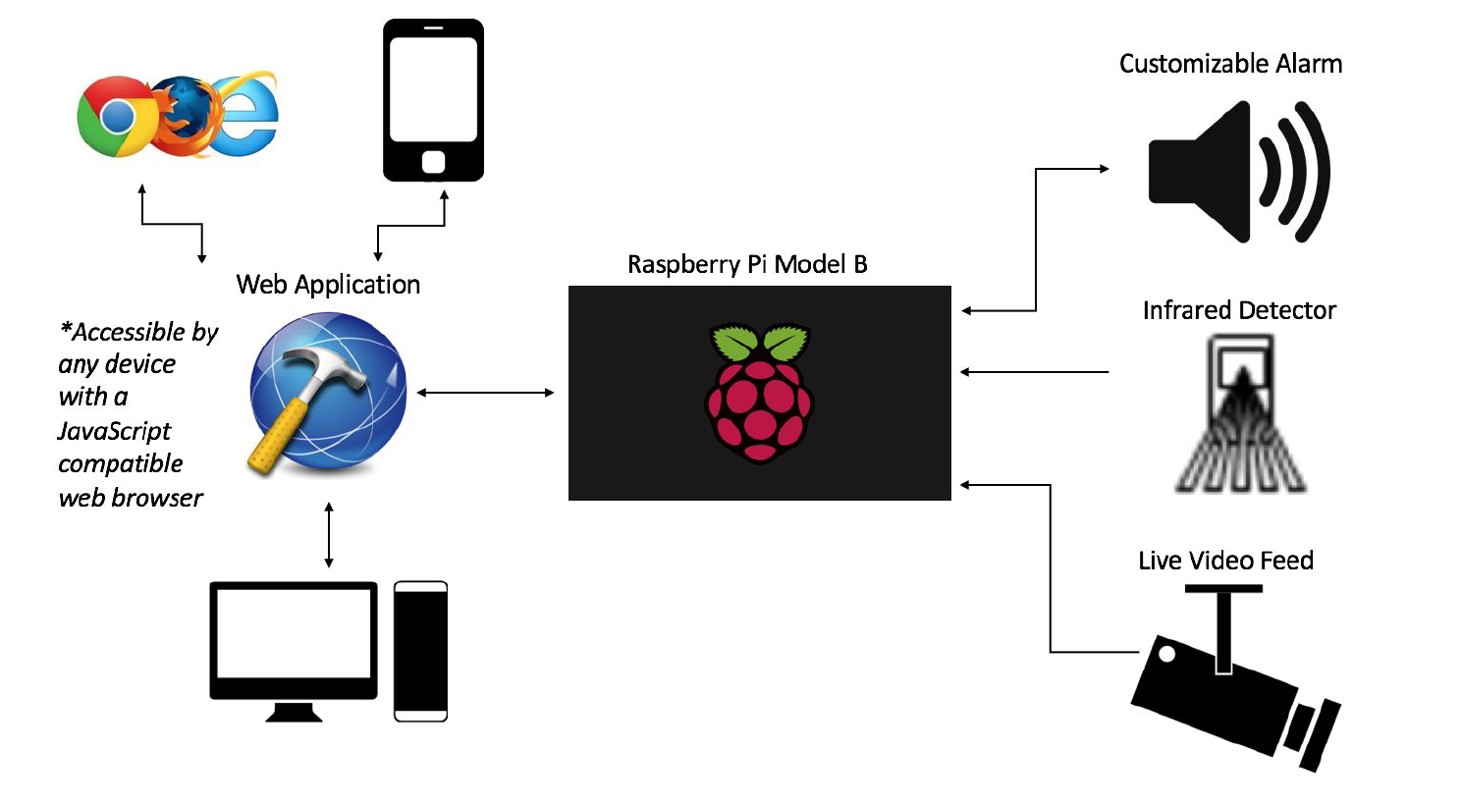

Design Approach
On Board PCB
Light Sensing Diode
JAM
Web Socket
Temperature Sensor

Slide 6
Software Flow
JAM
Server side
Client side
PI Server
(Apache)
Tornado Web socket
(Python)
JAM Webpage
(HTML5, CSS, JavaScript)
Data Acquisition/Processing (Python)

Slide 7
Progress
JAM
Web Server: Running
Web socket Server: Running
Able to control GPIO pins via the Web Page
Sub Circuits Designed
PCB Design Completed

Slide 8
What’s left?
JAM
Still to finish:
Scripting for web application
Web page design
Yet to start:
Python scripting for hardware
Outfit PCB with hardware
Building and integrating into enclosure

Slide 9
Tradeoffs of our Design
JAM
Current server structure not feasible for mass production
Remote Access methods create security loopholes
Does not have built in authority alert system
Video feed not practical at night
Prototype size
Limited audio output

Slide 10
Design Responsibilities
JAM
Mike – Circuit Design
Thadoe – Website Design
John – Software Design
This design work flow is the most efficient way to ensure that one part of the project is not slowed down because of setbacks in another
The longest journey lies ahead…Getting raw data from our PCB through the pi and finally to our webpage

Slide 11

Questions?

